Slide 1
Greedy approach
Knap sack Problem
Minimal spanning Tree
Prim’s Algorithm
Kruskal Algorithm
Optimal Storage on Tapes
Single source shortest path

Slide 2

Storage Tapes

Slide 3


Slide 4
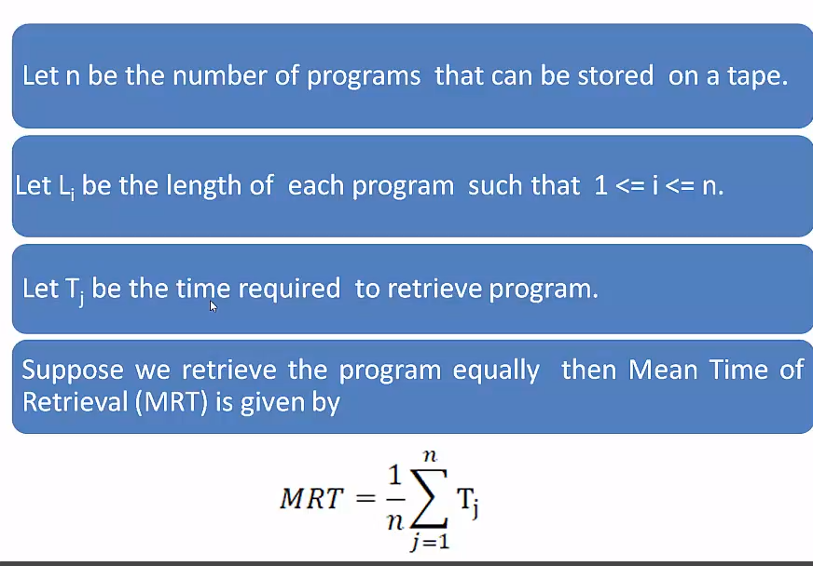

Slide 5


Slide 6


Slide 7
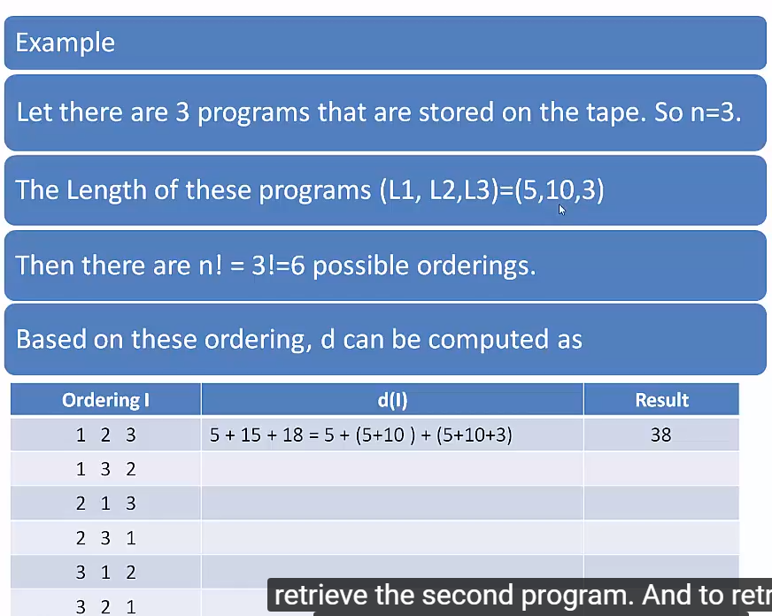

Slide 8
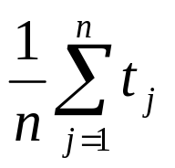
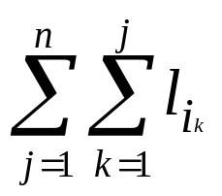
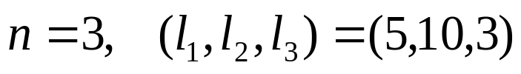
The goal is to minimize MRT (Mean Retrieval Time),
i.e. want to minimize
Ex:
There are n! = 6 possible orderings for storing them.
order
total retrieval time
MRT
1
2
3
4
5
6
1 2 3
1 3 2
2 1 3
2 3 1
3 1 2
3 2 1
5+(5+10)+(5+10+3)=38
5+(5+3)+(5+3+10)=31
10+(10+5)+(10+5+3)=43
10+(10+3)+(10+3+5)=41
3+(3+5)+(3+5+10)=29
3+(3+10)+(3+10+5)=34
38/3
31/3
43/3
41/3
29/3
34/3
Smallest

Slide 9
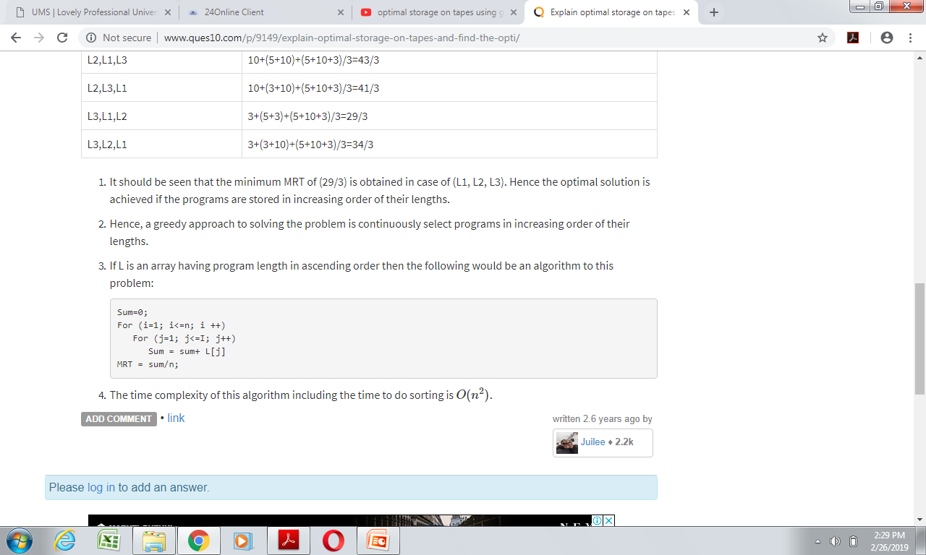
Hence, a greedy approach to solving the problem is continuously select programs in increasing order of their lengths.
Sum=0;
For (i=1; i<=n; i ++)
For (j=1; j<=I; j++)
Sum = sum+ L[j]
MRT = sum/n;

Slide 10
